Slide 1
Wesleyan goes Mobile

Slide 2
What is it?
Ellucian provides a mobile application just for colleges.

Slide 3
Who’s using it?
Over 2,400 institutions worldwide
This includes small colleges as well as major universities

Slide 4
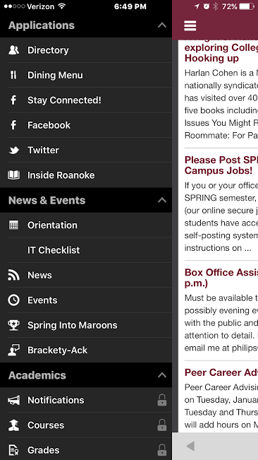
Roanoke College
Facility directory
Dinning menu
Social media
“Maroon card” – Marlin Dollars

Slide 5
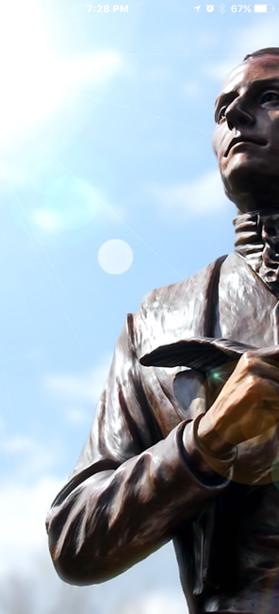
Emory & Henry
Bookstore
Shopping within application

Slide 6
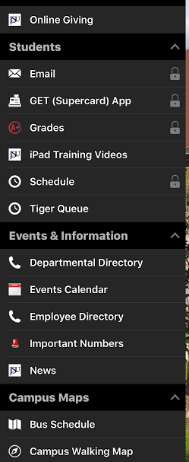
Jackson State University
Online giving

Slide 7
Challenges
Getting staff to transition to the application
Finding out what staff and students want in the application

Slide 8
What we need from you
Becoming a supporter
1
Get the communication department committed
2
Approve promotional materials utilizing your authority
3

